Slide 1

WEB PROGRAMMING LAB ASSIGNMENT
MCA, 3RD SEMESTER
SIKKIM UNIVERSITY
3RD NOVEMBER 2022

Slide 2

Portfolio Website Design using HTML & CSS
Make a portfolio website using HTML & CSS. The portfolio should contain some important information of yours like:
ABOUT ME
EXPERIENCE
PROJECT
EDUCATION
You can even add other details too in your portfolio and can make it more beautiful.

Slide 3
HOMEPAGE LAYOUT

Slide 4

ABOUT ME
EXPERIENCE
PROJECT
EDUCATION

Slide 5
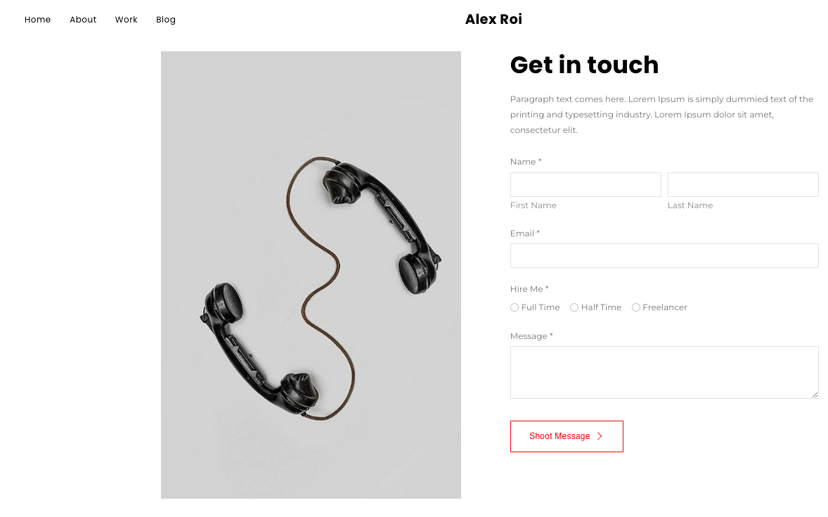
ABOUT ME
EXPERIENCE
PROJECT
EDUCATION

Slide 6
ABOUT ME PAGE LAYOUT

Slide 7
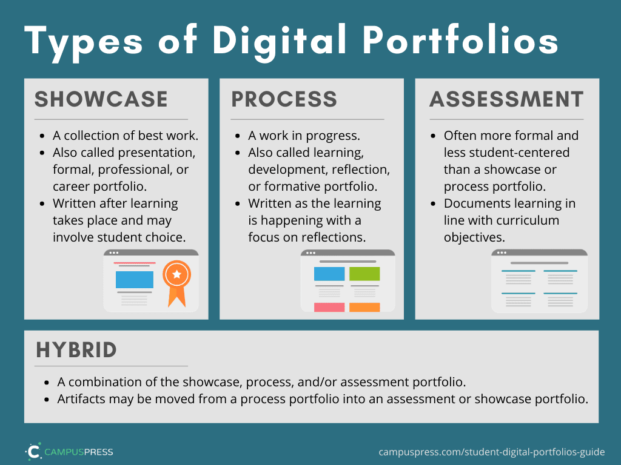

Slide 8
EXPERIENCE PAGE LAYOUT

Slide 9


Slide 10
PROJECT PAGE LAYOUT

Slide 11
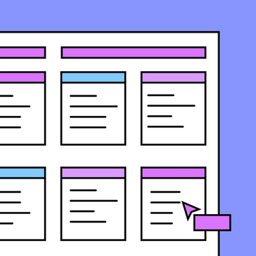

Slide 12
EDUCATION PAGE LAYOUT

Slide 13


Slide 14
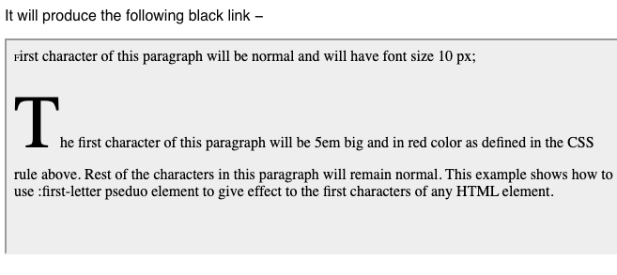
Following must be incorporated in the website.
Every webpage must have a visible border (color, width and border dash type can be any)
Add special style to links using pseudo class properties like hover, visited etc.
While writing paragraphs the first letter of first paragraph must be as shown below: (Hint- use pseudo-element)

Slide 15
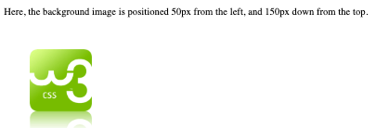
Following must be incorporated in the website.
Headings in the webpage must have larger and bolder font than rest of the text.
At least webpages must have a background image, rest should have colour other than white(i.e., background should not be white).
Every paragraph must have different background and text colour.
Every webpage must have a logo at a fixed position as shown below(Hint- use position property).
Use margin appropriately to align
paragraphs, text, images etc.

Slide 16
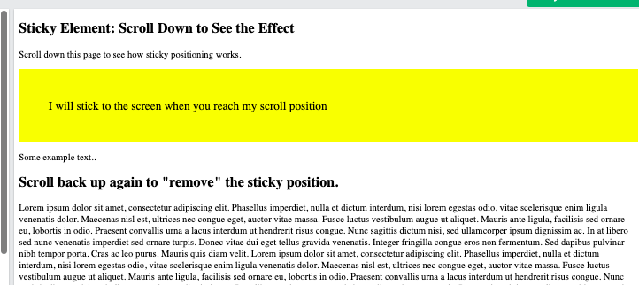
Following must be incorporated in the website.
Use padding for all four sides in any one of the webpage.
Add scrolling in the website and use the sticky position property.
Use float property to adjust image within a paragraph.(Hint-you can also use overflow property)
Use Grid boxes to insert text.(Hint- Use flexbox if needed). Use the concept of external CSS for styling your webpage.
At least one of the of the webpages must contain lists, embedded video, table, hyperlink, and a form with all types of buttons and text fields.

Slide 17
Following must be incorporated in the website.
Use padding for all four sides in any one of the webpage.
Add scrolling in the website and use the sticky position property as shown in figure.
Use float property to adjust image within a paragraph.(Hint-you can also use overflow property)
Use Grid boxes to insert text.(Hint- Use flexbox if needed). Use the concept of external CSS for styling your webpage.
At least one of the of the webpages
contain lists, embedded video, table,
hyperlink, and a form with all types of
buttons and text fields.

